Slide 1
DIGITISATION INITIATIVES OF THE E-COMMITTEE, SUPREME COURT OF INDIA

Slide 2
e-Courts project
The e-Courts project commenced in 2004 for ICT enablement of Indian judiciary with a vision to enhance judicial productivity both qualitatively and quantitatively.
It also sought to make the justice delivery system affordable, accessible, cost effective, environmentally sustainable, transparent and accountable.
It set in motion the process of digitisation of judicial administration across approximately 19,000 courts in India.

Slide 3
e-Courts project
Phase I of the e-Courts project was largely aimed at procuring and installing hardware and providing network connectivity. It operationalised the national e-Courts portal (http://www.ecourts.gov.in).
Phase II was more focused on providing citizen centric services to litigants and lawyers. These included development of an end-to end digitisation system (such as Case Information System), portals that enable people to access information about pendency of cases (National Judicial Data Grid).

Slide 4
Phase I and II
Installation of hardware in approximately 18735 court rooms.
VC facilities to 3240 Court Complexes and 1272 jails.
Computerisation of 652 District Legal Services Authorities and 2257 Taluk Legal Services Committee.
BSNL-MPLS WAN connectivity to Courts.
Development of CIS
Launch of NJDG, NSTEP, ICJS
eCourts services, JustIS app

Slide 5
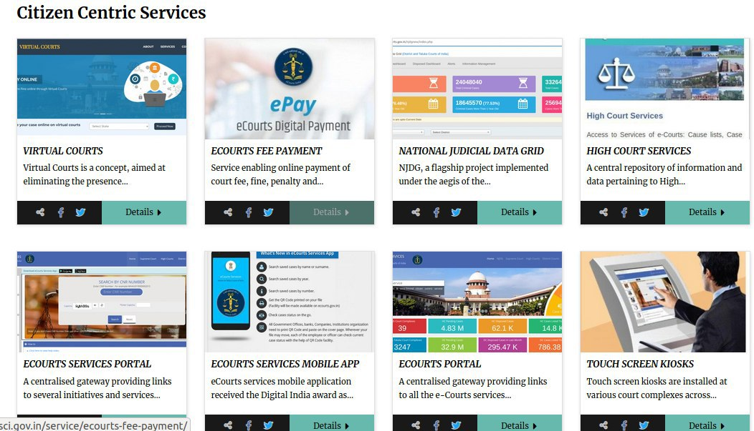
E-Committee Website
https://ecommitteesci.gov.in/ ​

Slide 6
On eCourts Website- Status of Case :
– CNR Number
– Case No.
– FIR No.
– Party Name
– Advocate Name
– Filing Number of the Case.
– Act Name
– Case Type Wise
Notes:
Court orders, cause list, caveat, location can also be searched

Slide 7
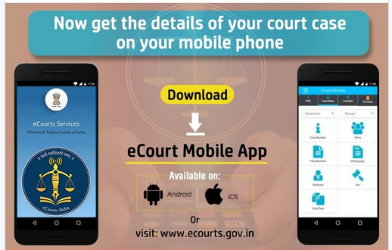
E-courts mobile app
The number of e-Courts services mobile downloads: 66,05,345 (As of 01.10.2021).

Slide 8
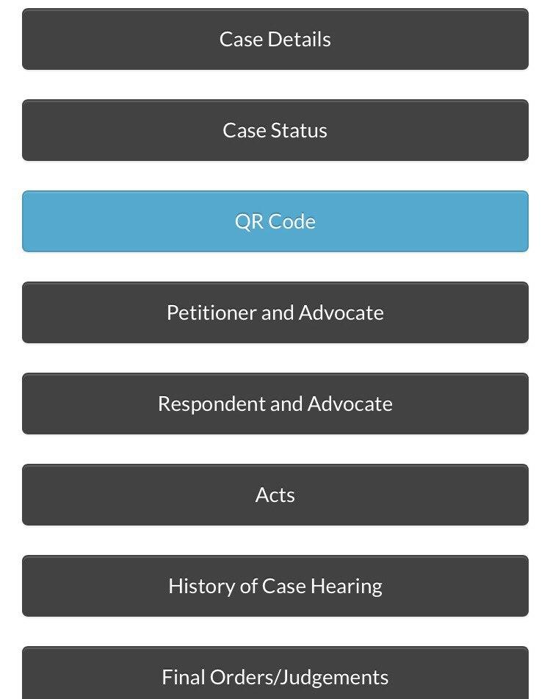
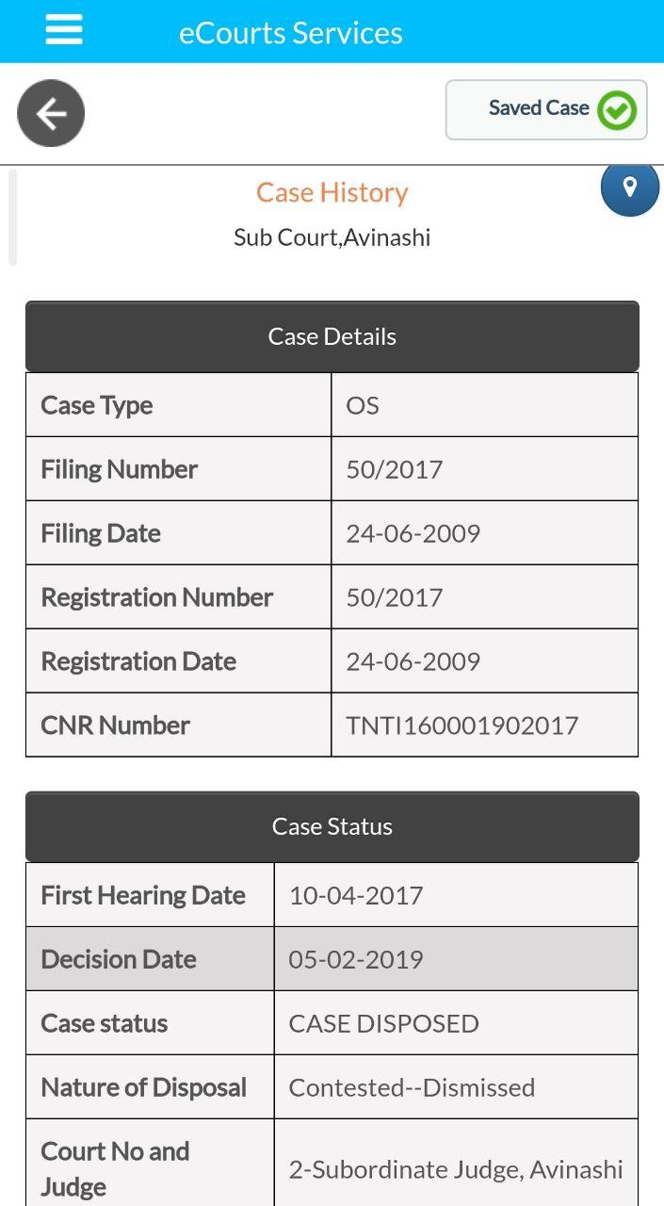
e-Courts mobile app- Case History

Slide 9
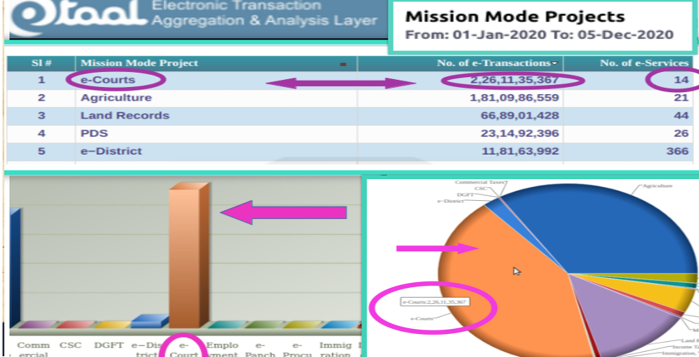
E-Courts Mission Mode Project ranked No 1 by eTaal
According to the eTaal (Electronic Transaction Aggregation & Analysis Layer) website (https://etaal.gov.in/)
e-Courts Project is ranked first under the category of mission mode projects for 2020 for providing the highest number of e-transactions to the citizen.
e-Taal Website has recorded 244.85 crore e-transactions in 2020 and 224.09 crore e-transactions from 1 January 2021 to 1 October 2021.
Average e-transactions for 343 days in 2020 was 67.06 lakhs per day.

Slide 10
NATIONAL JUDICIAL DATA GRID https://njdg.ecourts.gov.in/njdgnew/index.php
NJDG is a flagship project of e-Committee that tracks the country's pending cases, ensuring transparency in the functioning of the judicial system by making this information available in the public domain.
NJDG provides monitoring of pendency and disposal on various parameters to the citizens. Data from all high courts and district courts is available on NJDG.
As on date, date, data of more than 4,00,00,000 pending cases from District Courts and 56,00,000 cases of High Courts are available on NJDG.

Slide 11
NJDG – Total cases – 15,25,84,818 15,20,37,742

Slide 12
NJDG
NJDG gives the consolidated figures of cases instituted, disposed and the pendency of cases in all courts across the country.
These statistics are updated every day by respective courts.
The visitor can access information down to a particular case.
The pendency data at the national, state and district levels are open and in the public domain.
Data uploaded and collated on the portal can be accessed and analyzed;
● Category wise ● Year-wise ● State-wise
● Month-wise disposal of cases across institutions
● Across the original/appellate/execution stages of a litigation

Slide 13
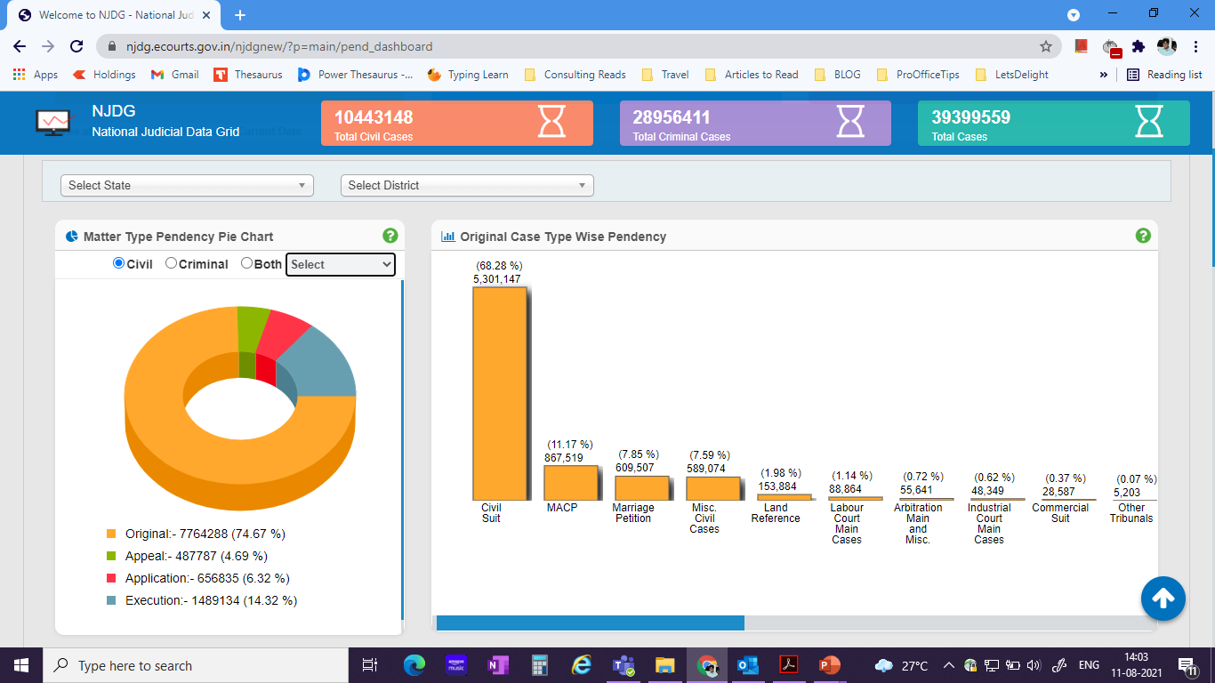
Matter Type Pendency
Overall pendency segregated according to each matter type is available on NJDG
25,587 Commercial Suits are pending as on 11th August 2021.
This forms 0.37% of the total pendency

Slide 14
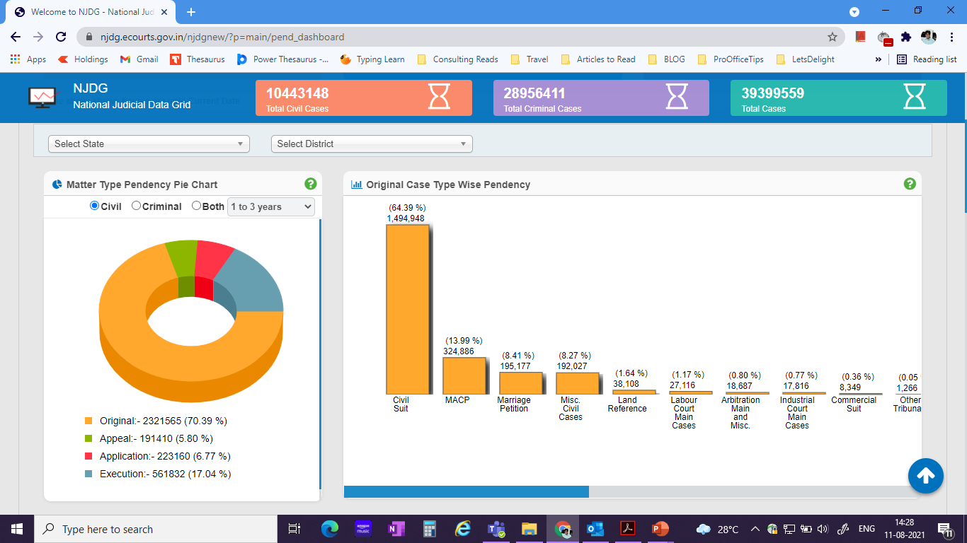
Matter Type Pendency
Matter type pendency can also be segregated according to number of years
e.g. 8,349 Commercial Suits are pending for 1-3 years

Slide 15
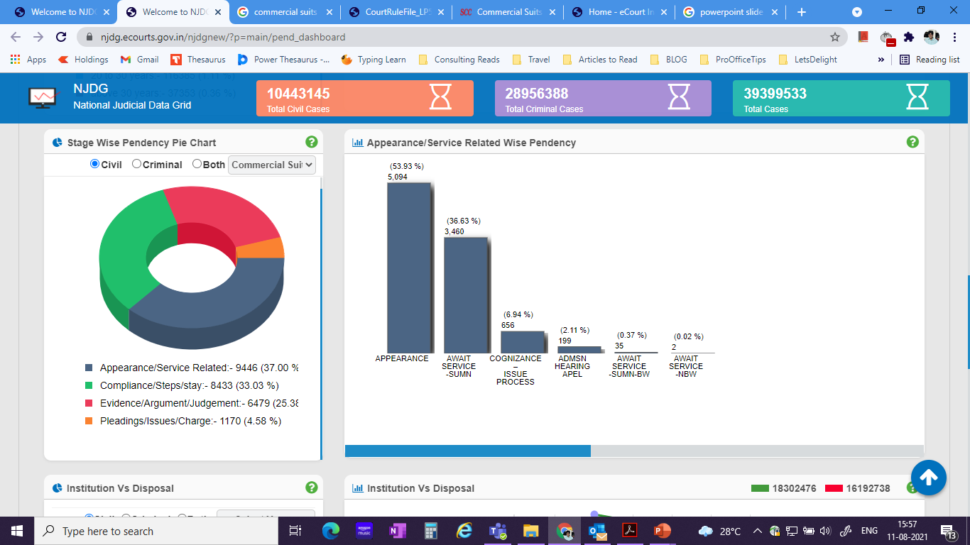
Stage wise pendency
The breakup of stagewise pendency for Commercial Suits can also be checked on NJDG

Slide 16
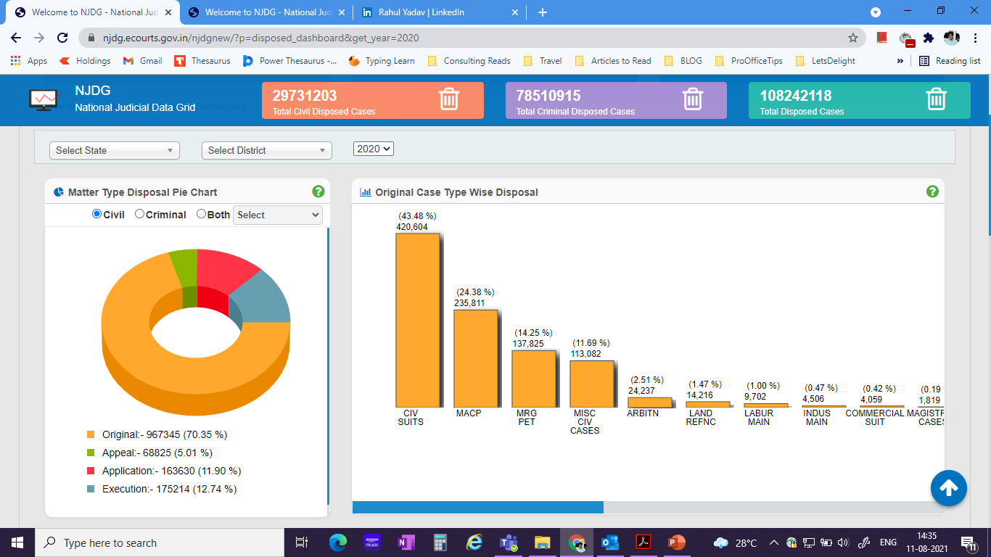
Matter Type Disposal
The number of disposed cases for each suit type is also available on NJDG
4,059 commercial suits were disposed in the year 2020 which forms 0.42% of the total disposed cases

Slide 17
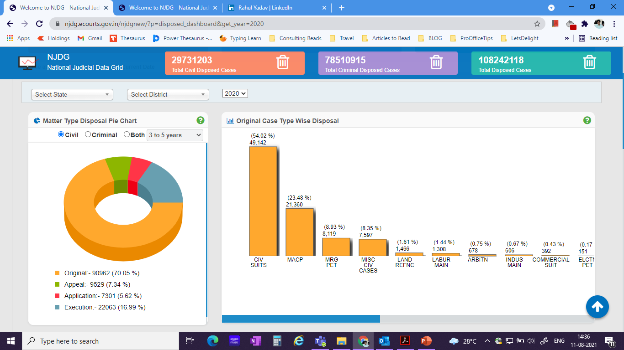
Matter Type Disposal
The disposal statistics can also be checked according to age of the case.
In the year 2020, 382 Commercial Suits with an age between 3-5 years were disposed

Slide 18
Disposal Case Type
NJDG portal also shows Time to Disposal for Commercial Suits

Slide 19
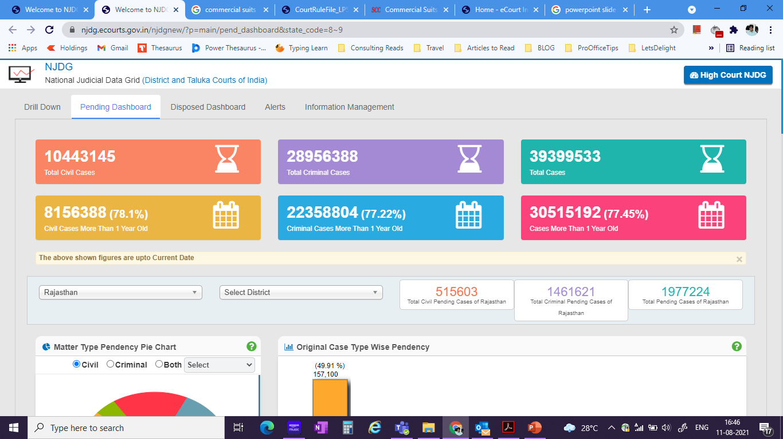
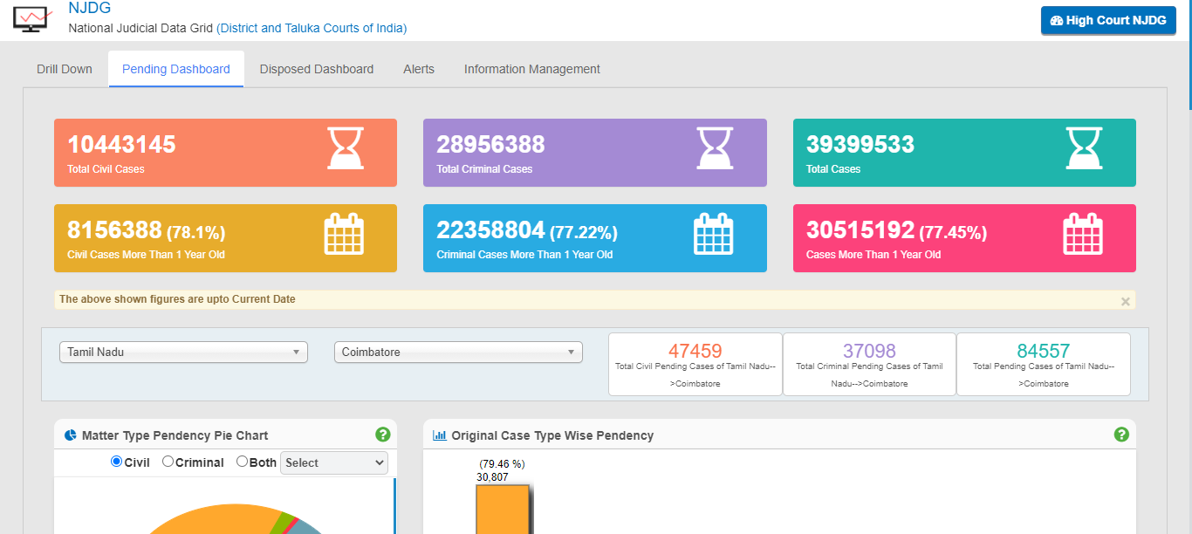
Availability of state wise and district wise data
The entire functionality shown previously is also available at individual state level and district level
The required state/district needs to be selected from the dropdown and the dashboard will get populated with respective data.

Slide 20
Automated services
SMS PUSH: Case status is sent automatically to the registered advocates and litigants through SMS by the CIS 3.0 software using SMS push facility.
SMS PULL: For litigants who have no internet connection, the case details can be obtained through the SMS Pull application by sending the CNR number to 9766899899 through SMS. An SMS with the case details will be sent automatically to the user mobile.
Automated emailing service to registered users: The CIS software will automatically send emails to advocates, litigants with the status of their case, next hearing date, cause list and judgment/orders if the user email is registered with the CIS software.
In 2021:
No of emails sent to Parties Advocates and Police Station: 8.46 Crore (Daily average 3.09 Lakh)
SMS sent to Advocates and Litigants: 5.69 Crore (Daily average 2.07 Lakh)

Slide 21
E- FILING- Promotes paperless filing- aims to create time and cost saving efficiencies by adopting technological solution to file cases before the courts.
e-Filing provides exchange of information and case papers not only between advocates and courts but also between advocates and clients.
e-Filing system is a complete end to end solution developed for online filing of plaints, written statements, replies and various applications related to cases.
It is designed as a bilingual software (English and local language) to reach a wider group of advocates/litigants.

Slide 22
E – SEWA KENDRA
Litigants who do not have access to the internet must be provided with access to services of the e-Courts. Hence, it was decided to create e-Sewa Kendras in all the High Courts and all court complexes.
The aim is to create a bridge between the judiciary and litigants/advocates who do not have digital access/ IT tools by developing a one-stop solution for e-services.
The motto is to provide access to justice to all and make available litigant centric information.
The mission is to overcome the digital divide in accessing services of e-Committee.

Slide 23
Facilities at e-Sewa Kendra
Handling inquiries about case status, next date of hearing, cause list, Judgment/Orders.
Facilitate online Applications for certified copies.
Facilitate e-Filing.
Facilitate scanning of hard copies of petitions, appending eSignatures, uploading them into CIS.
To assist in on line purchase of e-Stamp papers/e-Payments.
Facilitate disposal of traffic challans in virtual Courts and online compounding of traffic challans and other petty offences.
Explain the method of arranging and holding a video conference court hearing.

Slide 24
Virtual Court 16 court establishments across 12 States
Virtual Courts enables the public to get their traffic challans disposed of from the convenience of their home.
It eliminates the presence of a litigant or a lawyer in court premises through online adjudication.
As of 24th September 2021, fine has been paid in 17,05,912 cases and a total fine of more than Rs.180.63 crores has been collected.

Slide 25
E - PAYMENT
Online payment of court fees, fines, penalty and judicial deposits through an e-Payment link.
Citizens can now make payments online using this portal, eliminating the use of stamps, cheques and cash.
e-Payment portal is integrated with state-specific vendors like SBI ePay, GRAS, e-GRAS, JeGRAS and Himkosh.

Slide 26
National Service and Tracking Electronic Service (NSTEP)
The e-Committee has digitized the delivery of processes through NSTEP.
It consists of a centralised process service tracking application and a mobile app for bailiffs/process servers. NSTEP is used for the speedy delivery of processes and reducing inordinate delays in process serving.

Slide 27
Inter-Operable Criminal Justice System ( ICJS)
Live electronic exchange of data between courts and police through ICJS has been implemented in most High Courts.
FIR and charge sheet details are electronically received in courts through the CIS software system.
It will lead to seamless data exchange between the police stations' servers and the courts and reduce the courts' data entry work.
Metadata exchange of FIR and Chargesheet through ICJS has bene implemented in 21 High Courts.

Slide 28
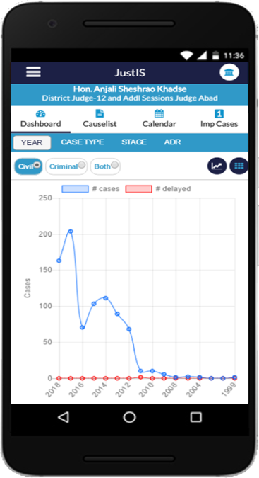
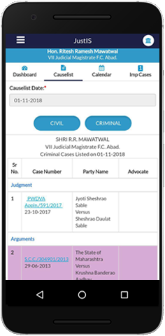
Facilities for Judicial Officers
JustIS Mobile App
JustIS Mobile App, provided to judicial officers, helps them to monitor pendency and disposal at finger tips.
Many reports, graphical and in grid form are available in the mobile app.
Calendar feature provides occupancy at a glance.
Facility to tag important cases and mark short note for such case is available. These cases are specially marked when listed. Judge can identify the cases of important nature on the cause list.
Dashboard
Cause List

Slide 29
ECMT TOOLS- EODB initiatives
Advocates
Judges
Access laws, regulations and case-law.
Access forms to be submitted to the court.
Receive notifications (e.g. emails).
Track the status of a given case (future hearings, deadlines, etc.).
View and manage case documents (briefs, motions, etc.).
File briefs and documents with the court.
Access court orders and decisions.
Access laws, regulations and case-law.
Automatic generation of a hearing schedule for all cases on the judge's docket.
Notifications (e.g. emails) to lawyers.
Track status of a case on the judge's docket.
View and manage case documents (briefs, motions, etc.).
Assistance with judgment writing.
Semi-automatic generation of court orders.
View court orders and judgments in a particular case

Slide 30
EODB initiatives – Automatic random allocation of cases
The e-Committee, Supreme Court of India has provided a patch in Case Information System (CIS) for automatic random allocation of commercial cases.

Slide 31
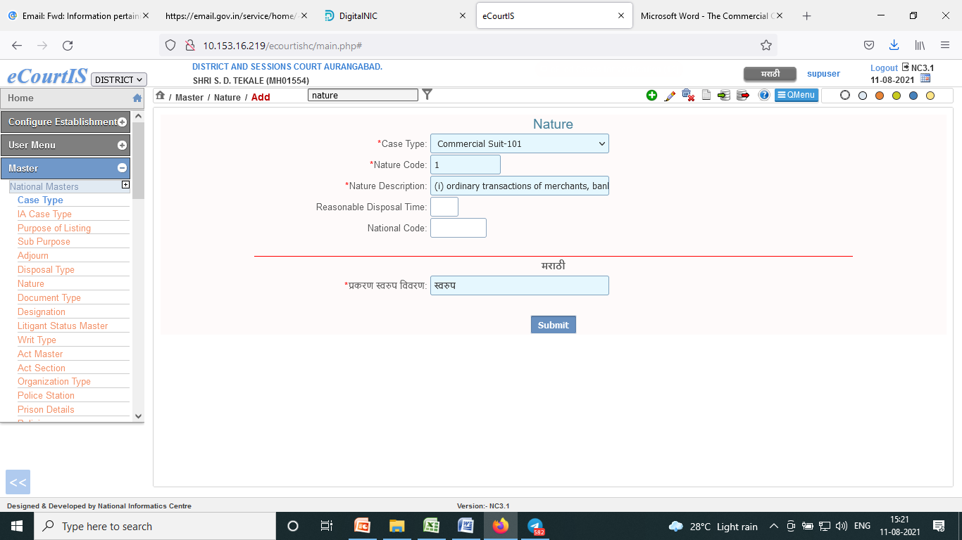
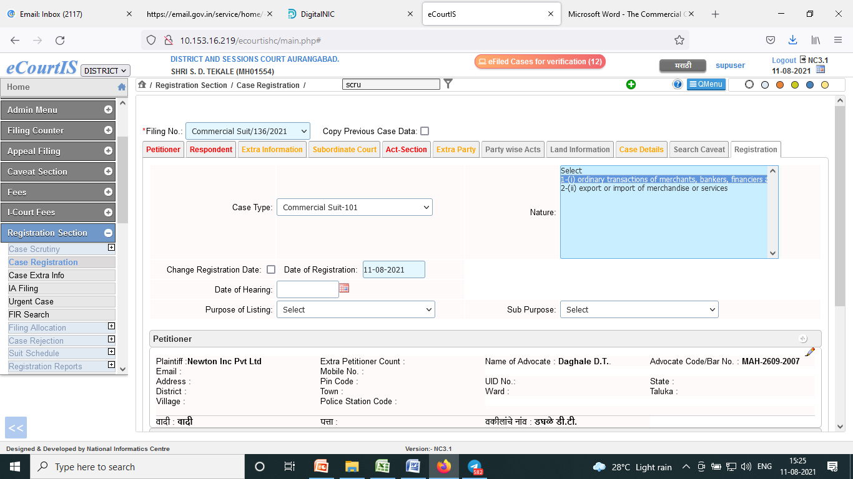
EODB – Initiatives
The 22 nature of commercial disputes as envisaged in the act can be entered in Nature Master available in CIS for Case Type Commercial Suits.
While registering the case, facility is available to select appropriate nature of commercial suit (even multiple natures can be selected, if the commercial suit falls under more than one).

Slide 32
EODB- Initiative case management hearing Pre trial conference in CIS

Slide 33
EODB-Initiative – integration of land records with CIS
Integration is in progress.
Pilot projects at Haryana, Uttar Pradesh and Maharashtra

Slide 34
Pandemic initiative Institution and disposal cases during Covid pandemic time in subordinate courts 24th March 2020 to 24th Sept. 2021
Cases registered during period - 2,07,76,396
Cases disposed during the period- 1,38,04,680
This was made possible due to the robust digital infrastructure created during Phase I and Phase II of the e-Courts Project.

Slide 35
Other initiatives of eCommittee
Model rules of video conferencing for courts.
Model rules of e-Filing for courts.
Model rules for live streaming of court proceedings.
SOP for digital preservation of judicial records.
Vision Committee.
Sub-Committee for preparing e-Registers.
Sub-Committee for marginalized sections.

Slide 36
e-Courts project
Phase III of the e-Courts project in India is rooted in two facets central to Gandhian thought - access and inclusion.
It envisions a judicial system that is easily accessible irrespective of geographical location, digital literacy and is equitable.
It aims to adopts the latest technology for a positive environmental impact.

Slide 37
Digitization
Digitization is critical to the e-Courts project to provide various citizen centric services to litigants and lawyers.
Digitization of court records is at the core of the ICT enablement initiatives in judicial domain in Phase III.

Slide 38
The Parliamentary Standing Committee’s 103rd Report on ‘Functioning of Virtual Courts/Court Proceedings through Video Conferencing’
The digital transformation of the judiciary has important implications for clearing a significant backlog of cases.
It will make justice accessible and affordable to a large section of the population and help in overcoming physical and logistical barriers which prevent many litigants from seeking justice.

Slide 39
The Parliamentary Standing Committee’s 103rd Report on ‘Functioning of Virtual Courts/Court Proceedings through Video Conferencing’
The Committee is of the opinion that introduction of virtual courts would result in an improvement over traditional Courts as they are more affordable, citizen friendly and offer greater access to justice.
There is a need to integrate virtual courts into the country’s legal ecosystem.

Slide 40
The Parliamentary Standing Committee’s 103rd Report on ‘Functioning of Virtual Courts/Court Proceedings through Video Conferencing’
The Committee noted that the transition from physical courtrooms to virtual courtrooms requires massive investment as basic infrastructure required to support digitized court hearings such as (i) electronic case files; (ii) equipment to project documents and images, audio and video; (iii) tools to record hearings; (iv)videoconferencing tools; and (v) reliable WiFi needs to be put in place.

Slide 41
Ease of Doing Business (EoDB)
The Department of Justice has emphasised that establishment of paperless/digital commercial courts along with expeditious digitization of commercial court records is the key to improving performance on this parameter.

Slide 42
Digitization
Digitization of case records will not only aid the successful conduct of court proceedings in virtual courts, as desired by the Parliamentary Standing Committee but will also lead to an efficient and effective enforcement of contracts under EoDB.

Slide 43
Digital Preservation Standard Operating Procedure (SOP) for scanning, storage, retrieval, digitization of court records and preservation of legacy data of the judiciary…… Committee.
Hon’ble Dr. Justice D. Y. Chandrachud, Chairman, e-Committee, Supreme Court of India
Hon’ble Mr. Justice Ravindra Bhat, Judge, Supreme Court of India
Hon’ble Mr. Justice Satish Sharma, Judge, Karnataka High Court
Hon’ble Mr. Justice Rajiv Shakder, Judge, Delhi High Court
Hon’ble Mr. Justice Aravind Kumar, Judge, Karnataka High Court
Hon’ble Mr. Justice T S Sivagnanam, Judge, Madras High Court
Hon’ble Mr. Justice Nitin Jamdar, Judge, Bombay High Court
Hon’ble Mr. Justice Badar Durrez Ahmed, Former Chief Justice, J & K High Court.
Hon’ble Mr. Justice (retd.) R C Chavan, Vice Chairperson E Committee.

Slide 44
Digital Preservation Standard Operating Procedure (SOP) for scanning, storage, retrieval, digitization of court records and preservation of legacy data of the judiciary – Objectives……………….
Digital preservation digital records and address the looming challenges and threats of technological obsolescence;
Envisage an interoperable implementation model and trustworthy mechanism for digital preservation of judicial data boosting efficiency, consistency and exchange of reliable records / data between judicial entities;
The document incorporates select ISO standards where an exhaustive set of globally accepted and auditable best practices, procedures and methods are readily available;
Create Judicial Trustworthy Digital Repositories (JTDRs) as an interoperable and reliable source of digital records.

Slide 45
Advantages of digitization of court records
Efficient court and case management.
Virtual Courts.
Safe and secure.
Disaster recovery.
Environment friendly process.
Cost Effective.

Slide 46
Digitization Survey I, II & III (Legacy Records + Future Projection)
LEGACY RECORD | 1242,93,90,000
PENDING CASES | 350,41,50,000
INSTITUTION PROJECTION FOR NEXT 5 YEARS | 1515,41,61,828
TOTAL PAGES | 3108,77,01,828

Slide 47
BUDGET ESTIMATE Budget Estimate_Digitization.docx
BUDGETARY HEADS | YEAR- 1 (in Cr) | YEAR- 2 (in Cr) | YEAR- 3 (in Cr) | YEAR- 4 (in Cr) | YEAR- 5 (in Cr)
Digitization | 388.4 | 388.4 | 388.4 | 388.4 | 388.4
Judicial Digital Repository | 247.82 | 88.61 | 81.62 | 91.57 | 129.78
Digital Preservation Tools and Software Solutions | 24.87 | 17.93 | 18.23 | 16.63 | 18.71
TOTAL | 661.09 | 494.94 | 488.25 | 496.6 | 536.89
GRAND TOTAL | 2677.77
TOTAL PAGES | 3108,77,01,828
TOTAL COST | 2677.77 Crore
COST PER PAGE | 0.86

Slide 48
Digitization initiatives
To achieve the ICT enablement of Indian Judiciary in its true sense, digitization of court records is of utmost importance and needs to be addressed on priority.
Budgetary support is the key to the success of this project.

Slide 49
Thank You………………

